Slide 1
Business Continuity and Resiliency

Slide 2
Business Continuity
Ability to perform business functions during and after adverse condition such as a natural disaster, failure of a service.
Ensure internal and external application, workloads, services remain operational during planned downtime and unplanned outage.
Architecting for resiliency focuses on failure recovery, rather than avoiding failure.

Slide 3
High Availability and Disaster Recovery
High Availability – Ability of the application to continue running in healthy state despite localized or transient failures. It relies on the redundancy of application component and automatic failover
Disaster Recovery – Recover from major incidents. Data backup and archiving
Ex: Order processing application

Slide 4
Virtual Machine High Availability
Availability Sets – Single Point of Failure
Availability Zone – Datacenter level failure
Virtual Machine Scale Set – Autoscaling
Replication of VM
Multi-Region

Slide 5
Storage Replication
LRS - 3
ZRS - 3
GRS - 6
RA-GRS - 6
GZRS - 6
RA-GZRS - 6

Slide 6
Data Backup
Backup is distinct from the data replication
Data replication is copying data in near real time
Point in time restore needs a data backup
Storage – Snapshots, Backups
VM – Backup in recovery services vault
App Services – Storage Account
SQL Database on Azure VM – Backup in recovery services vault

Slide 7
Identifying Requirements
Recovery Time Objective (RTO) Maximum acceptable time that an application can be unavailable after an incident. Ex: RTO of 90min
Recovery Point Objective (RPO) Maximum duration of data loss that is acceptable during a disaster. Ex: Store data in a single database, perform hourly backups, you could lose up to an hour worth of data
Mean Time to Recover (MTTR) Average time it takes to restore the application after a failure.

Slide 8
Service Level Agreements
Maintain uptime and connectivity
Obtain service credits incase SLAs are not met

Slide 9
SLA
Single VM with Premium Disk – 99.90%
Availability Sets – 99.95%
Availability Zones 99.99%

Slide 10
Estimating SLA Downtime
Ex: Web App writes the data to Azure SQL Database
App Service – 99.95%
SQL Database – 99.99%
Composite SLA = 99.95% x 99.99% = 99.94%
Web App AND (Database or Queue) ~ 99.95%

Slide 11
Application Design

Slide 12
Application Design: Failure Mode Analysis
Process of building resiliency into application in early design stage
Identify failures that an application might experience
What is the impact of these failures on application
Identify recovery strategies

Slide 13
Ecommerce Application
Performance/loading of site/slowness
Payment Outage
Connection Error
Product Availability Update (Feature Request)
Login Issues
Inconsistent Data
Over or Under Selling (Feature Request)
Page not found – 404 error
Feedback/support issue
Load Balancing
Database Failed
Network Failure

Slide 14
Ecommerce Application
Application not reachable – 404, 5xx – HA, scalability
Slow response from some pages – throttling – 429 – too many request – Scalable, DDoS
Authentication – HTTP 401 (unauthorized) – HTTPS, SSL Certificates
Website not being browser compatible – Application Design, Responsive
Component Failure – Individually FMA of component
Integration Service – DB, Messaging, LB
DDOS – Basic, Application level attacks you should take care.

Slide 15
Avoiding a Single Point of Failure
Single VM - SLA with Premium Disk - 99.90%
Availability Sets – Fault Domains and Update Domains – 1 Single DC Ex: 2 Web Server and 2 Database Servers
Availability Zones
Azure Site Recovery
Paired Regions

Slide 16











Azure Autoscaling and Load Balancing
Placing two or more VMs behind a load balancer
Scaling out an Azure App Service app to multiple instances
Using Azure Traffic Manager
VMSS

Slide 18
Traffic Manager
Priority
Performance
Geographic
Weighted

Slide 19
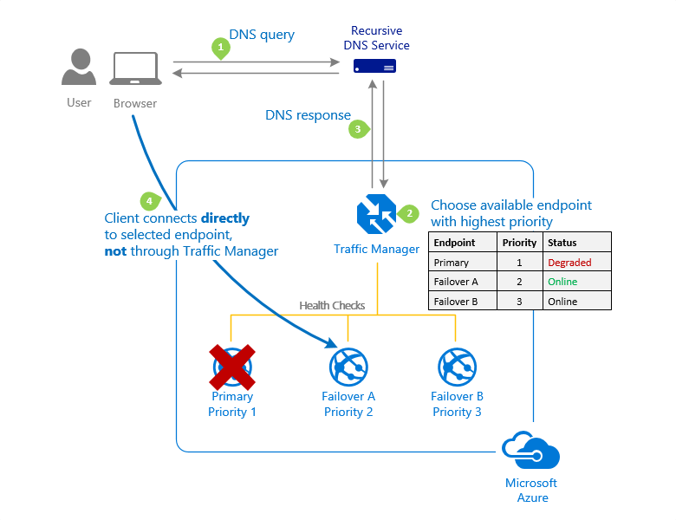

Slide 20
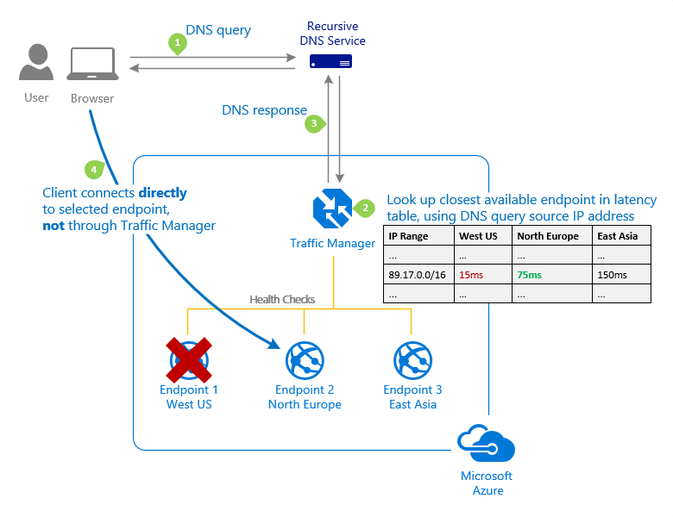

Slide 21
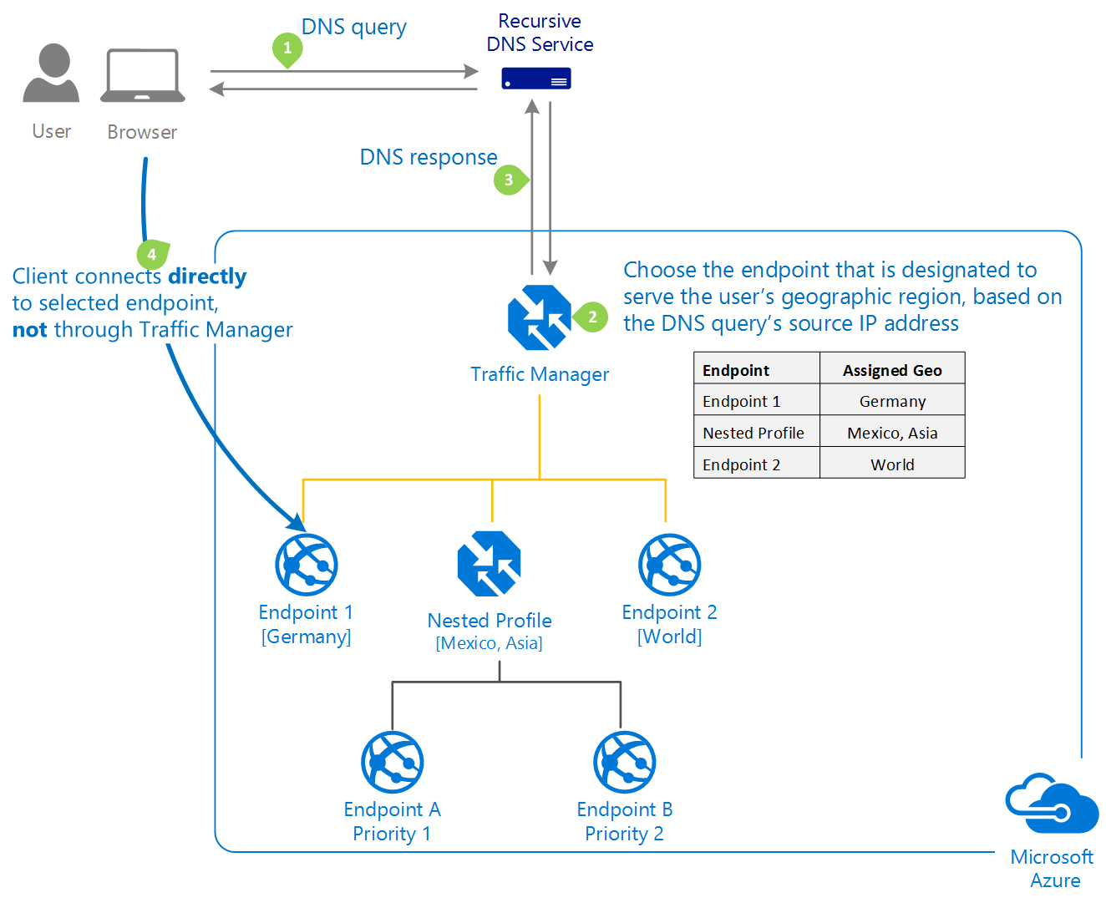

Slide 22
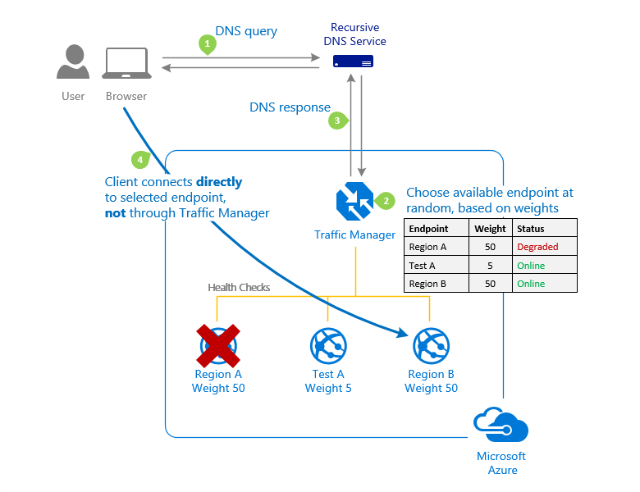

Slide 23
You need to deploy a web application and ensure below criteria is met
You should be able to scale upto 15 instances of application
You should be able to take 15 backup of application daily
You should be able to have auto scaling support for application
Which app service plan should you choose
Basic – Upto 3 instances
Standard – 10 instances, 10 times daily backup
Ultimate – Easy Elimination
Premium – 20 instances, 50 times daily backup
Free – Easy Elimination

Slide 24
You need to deploy below web app
How many minimum app service plans due to need to ensure the deployment and cost be minimized.
A. 1
B. 2
C. 3
D. 4
E. 8
Web App | Technology
Web App 1 | .Net 4.8
Web App 2 | Ruby
Web App 3 | Node JS
Web App 4 | Java

Slide 25
Workload Service level Objectives
Configure workloads by service level objectives
Critical and less-critical workloads

Slide 26
E-commerce
Frontend – Non-critical
Cart and Checkout - Critical
Payment Gateway - Critical
Login - Critical
Inventory – Non-critical
User Profile – Non-critical
Customer Service – Non-critical
Search – Huge Load - Critical

Slide 27
Video Streaming Application (Netflix, Hotstar, Amazon Prime)
Live Streaming Engine - Critical
Storage - Critical
Video Compression – Non-critical
UI – Non-critical
Login - Critical
Profiles – Non-critical
Search - Critical
Commenting Capability – Non-critical
Monetization – Non-critical
Last Played Status – Non-critical
Database - Critical
Payment - Critical
Inventory – Non-critical
Video Player - Critical

Slide 28
Enhancing Security
DDoS – Network Layer
DDoS – Application Layer – Captcha, Image Recognition
SSL Certificate – HTTPS
Principal of least Privilege – RBAC
MFA – Authorization and Authentication
NSG

Slide 29
Hacking
Phishing – Ensure you watch URL properly – Fake mail – facebook.xyz.com
Key Logging
Simple Passwords – Mobile Number, Yourname@birthyear, Yourspousename@birthyear – Brute Force Attack
Security Questions – Right answers to the security question
Ethical Hacking - Learning

